Slide 1
2023-24
ANNUAL REPORT
September 26, 2024
CELEBRATING 23 YEARS of SERVICE!

Slide 2
"Doug, I feel like I have been let out of jail! I can read again!"​
Paul Hutchinson
Fort Collins Lion, 1947-2003
Lions President, 1981
CELEBRATING 23 YEARS of SERVICE!​

Slide 3
Thank you!!!
Special THANK YOU to the Fort Collins Lions Club and the Fort Collins Lions Foundation for your awesome support!
CELEBRATING 23 YEARS of SERVICE!

Slide 4
Ensight Exemplifies the Lions’ Mission
Helen Keller, speaking at the 1925 Lions Clubs International Convention:
“I challenge Lions to become the Knights of the Blind in the crusade against darkness…”
CELEBRATING 23 YEARS of SERVICE!

Slide 5
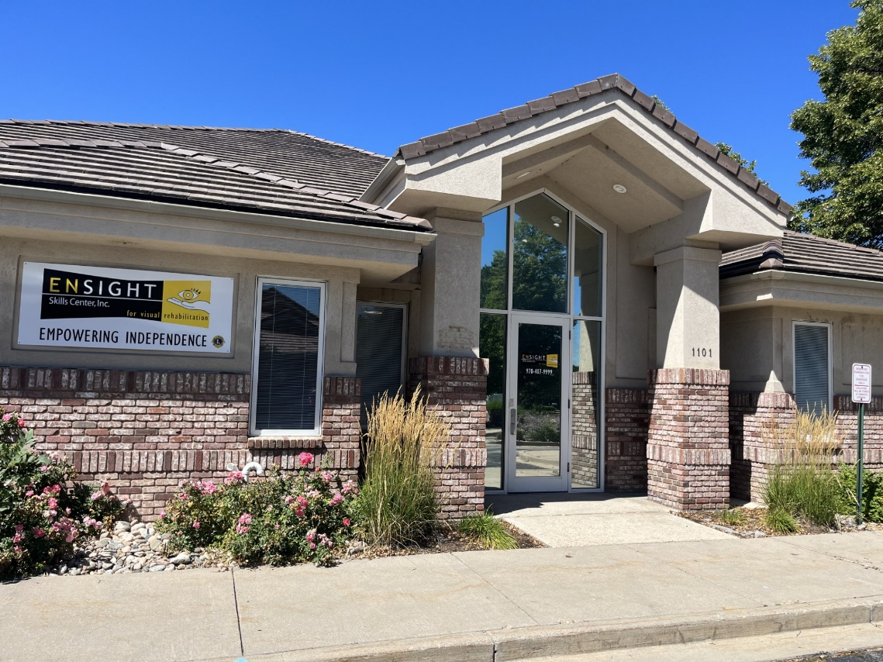
Ensight Exemplifies the Lions’ Mission
Ensight crusades against darkness by:
Empowering Independence!
CELEBRATING 23 YEARS of SERVICE!

Slide 6
ENSIGHT Facilities
Ensight Offices
Fort Collins Ensight- New office!
Greeley Curtis Strong Center
Satellite Locations
Eye Care Center of Northern Colorado,
Lafayette
Boulder
Colorado Retina Associate
Cherry Creek
Denver Eye Surgeons in Lakewood
Thornton Community Center
Mobile OnSite Services
Grand Junction
Rifle
Montrose
CELEBRATING 23 YEARS of SERVICE!

Slide 7
2022-23 Ensight
Board of Directors
Fort Collins
Doug Hutchinson, Chairman (Lion)
Richard Faubion, Vice Chairman, (Regional Director for the Foundation Fighting Blindness)
Tana Arther, Secretary (Community Member, Parent/Consumer)
Dr Arthur Korotkin (Ophthalmologist)
Penn Street (Lion PDG, Consumer)
Felicia Korpi (Panorama Vision) NEW
Boulder
Carl Gentzel, CPA, Treasurer (Lions 6C PDG)
Denver Metro Area
Jalaya Alexander (pediatric nurse)
NEW- Eric Arther- Denver, CO First National Bank
CELEBRATING 23 YEARS of SERVICE!

Slide 8
ENSIGHT Staff
Denny Moyer, BS, COTA/L, SCALV, President/CEO,
Co-founder, 23 years of service
Melody Bettenhausen, BS, COO, 14 years of service
Cory Layton, O.T.R., SCLV, Director of Rehabilitation, Registered Occupational Therapist, Low Vision specialist. 20 years of service
Corey Bernhardt, O.D. (Doctor of Optometry). Low vision doctor, 8 years
Anjana Sharma O.D. (Doctor of Optometry) Low vision Doctor 4 year
Jennifer Rise, COTA/L. Certified Occupational Therapy Assistant, 9 years
Annette Biddson, Administrative Assistant, 10 years
Amy Heath, Administrative Assistant, 3 years
Danielle Burden, COMS, 5 years
Penn Street, support group 3 years
Ellie Carlson, COMS, 4 year
Daiva Ragas OTR (Denver based)- New
Monica Waldorf- OTR Erie) - New
Note: Bold = Full-Time
CELEBRATING 23 YEARS of SERVICE!

Slide 9
Significant Agency Collaborations
AfterSight
Weld Legacy Trust
Wyoming Lions Clubs
Colorado Lions Clubs
Elder Care Network
Hillcrest Senior Living
Rigden Farms
Columbine Health Systems
Local community services, including:
Lutheran Family Services, Catholic Charities,
House of Neighborly Services
Colorado State University
Pima Medical Institute
Hadley School for the Blind
Berthoud Senior Center
Eaton Senior Center
Colorado Talking Books Library
World Services for the Blind
Division of Vocational Rehabilitation and Veterans Administration
Older Individuals who are Blind
Denver Regional Counsel of Governors
Office on Aging and the (ADRC) Aging disability resources of Colorado.
Larimer Office on Aging
Weld and Boulder Area Agency on Aging
Tru-Pace senior medical care
Center for Independence in Grand Junction, and Center for Independence in Pueblo Disabled Resource Services,
Center for People with Disabilities
Center for Independence
Connections for Independent Living
Eye Center of Northern Colorado
Eye Care Center of Northern Colorado
Colorado Retina Associates
Denver Eye Surgeons
Foundation Fighting Blindness
CELEBRATING 23 YEARS of SERVICE!

Slide 10
Perspectives on Ensight Services
Direct Professional Services
- Low-vision optometrist and Occupational Therapist evaluation
- OT home visits
- Orientation and mobility training
Assistive Technology
Education, Resources & Assistance
- Education
-- Prevent blindness
-- Safety: balance classes, Stepping On, etc.
-- Teaching hardware, software use
- Resources
-- Collaborations
-- Colorado Talking Book Library
-- Audio Information Network
-- Transportation Resources
-- Technology; Ensight sales
- Assistance
-- Visual Aids information
-- Home equipment training
-- References to other services
CELEBRATING 23 YEARS of SERVICE!

Slide 11
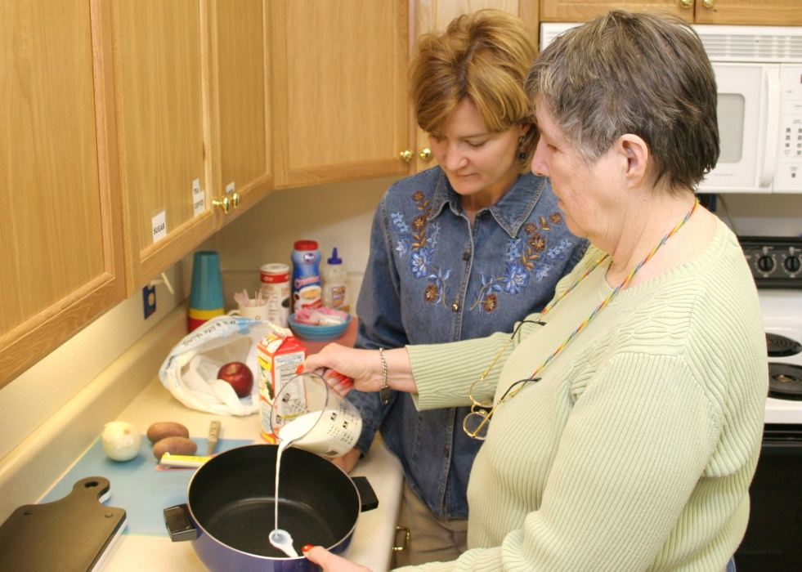
2023-2024 Services
Direct Services Include
Doctor
Occupational Therapy
Orientation & Mobility
Assistive Technology
Total Served: 787

Slide 12
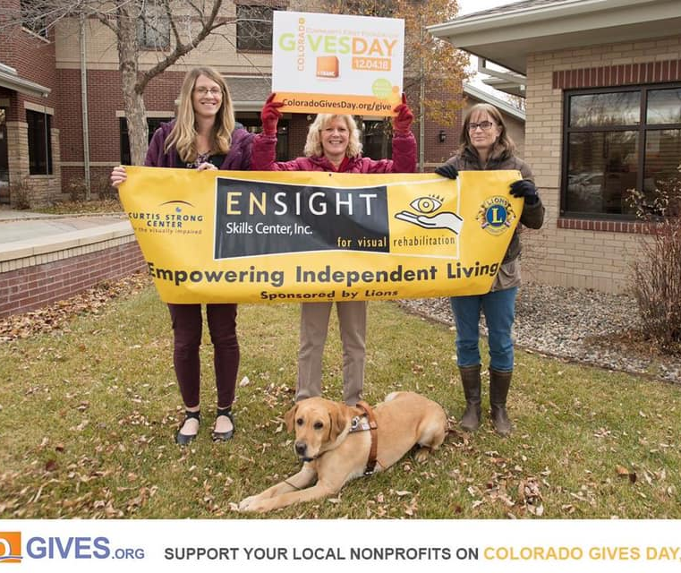
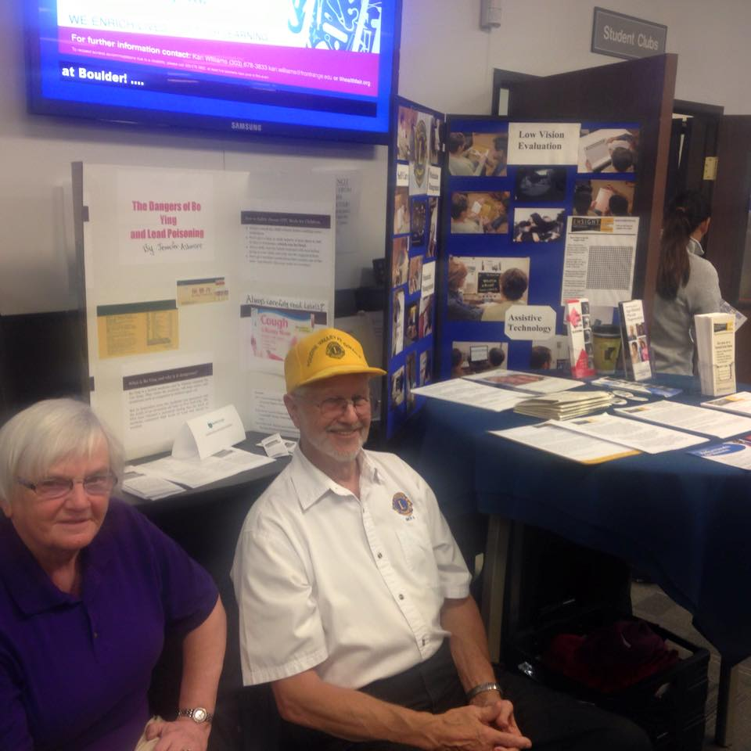
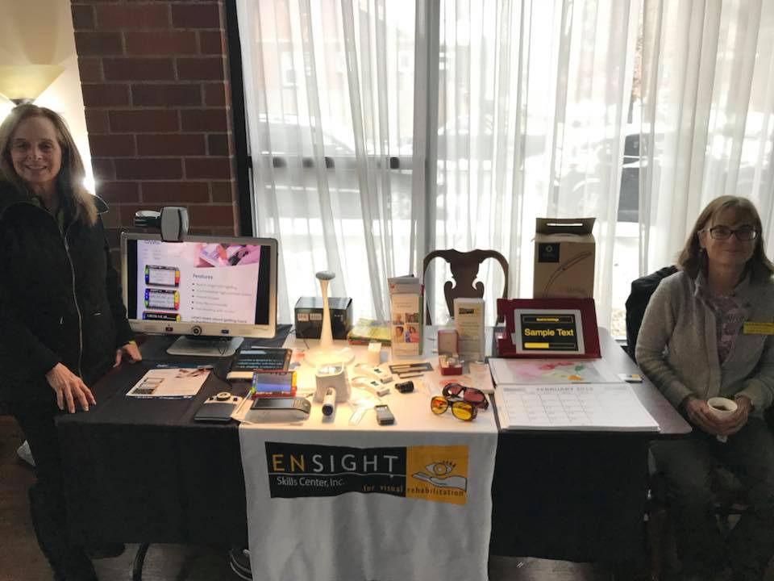
2023-2024 Community Outreach
8879 Individuals served through Education, Social Activities, Resources and Assistance

Slide 13
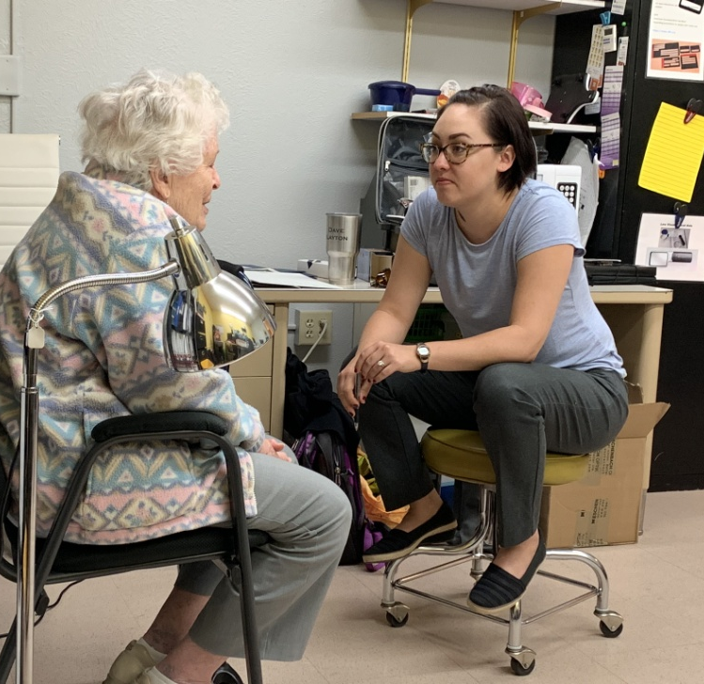
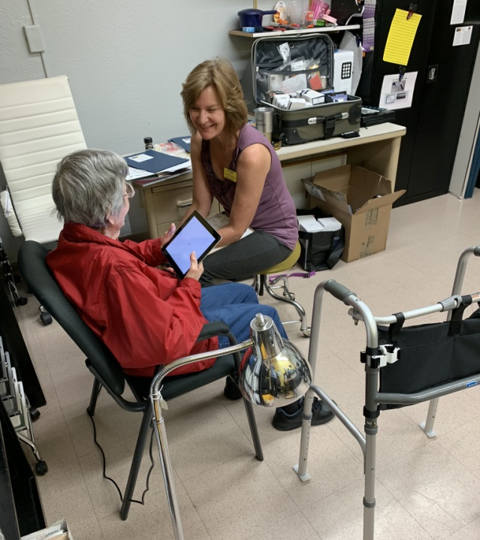
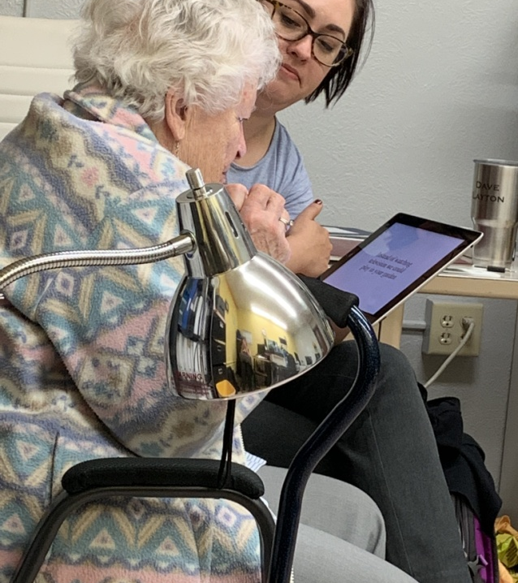
Ensight Onsite

Slide 14
Perspectives on Ensight Services
All service data
CELEBRATING 23 YEARS of SERVICE!

Slide 15
Direct Professional Service Fees
CELEBRATING 23 YEARS of SERVICE!

Slide 16
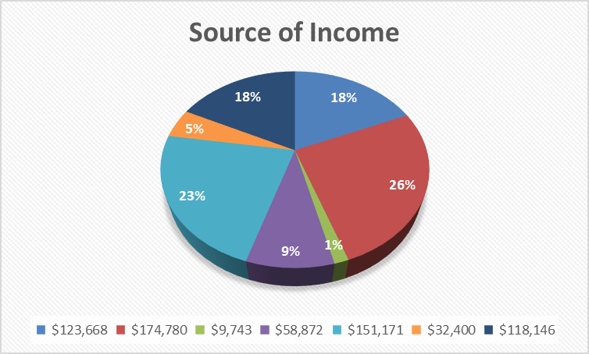
2023-24 Revenue Sources
$ 123,668 | 18.5% | Government grants/contracts (federal, state, county, local)
$ 174,780 | 26.1% | Foundations/workplace giving campaigns
$ 9,743 | 1.5% | Events (include event sponsorships)
$ 58,872 | 8.8% | Individual contributions
$ 151,171 | 22.6% | Fees/earned income
$ 32,400 | 4.8% | In-kind contributions (if included in financial statements)
$ 118,146 | 17.7% | Other (list): Inventory sales
CELEBRATING 23YEARS of SERVICE!

Slide 17
2023-24 Historic Gross Income
CELEBRATING 23 YEARS OF SERVICE!

Slide 18
MAJOR CONTRIBUTORS 2023-24
Weld Legacy Trust Foundation $119,500
Older Individuals Who are Blind Fund – DVR $116,265
Fort Collins Lions Foundation $28,726
Denver Regional Council of Government $70,060
Larimer County Office on Aging $24,000
O’Rourke Foundation $20,000
Weld County Area Agency on Aging $21,000
Aging & Disability Resources of Mesa County $3600
Community Foundation of Boulder County $2,000
Community Foundation of Northern Colorado $1,000
City of Fort Collins $15,000
All other Colorado Lions Clubs $5,370
Metric Motors $4,000

Slide 19
Lions Club Contributions!
Fort Collins Noon
Centennial Airport
Golden
Loveland
Denver Five Points
Woodlin
Calhan
Mountain
Brush
Total Lions Donations= $34,096!!

Slide 20
The Bottom Line:
2023-24 Profit and Loss Statement
GROSS REVENUE EXPENSES NET REVENUE
Total
Operations: $760,082 $702,271 $ 57,811
CELEBRATING 23 YEARS of SERVICE!

Slide 21
ENSIGHT Milestones
Celebrated 23 years of service
Melody Bettenhausen, COO received award from VSA
Have served over 130,000 individuals
Secured over $285,000 in City, County and State Contracts
This FY served 9,606 individuals
Growing expansion of donor base
Denver service expansion
Cherry Creek
Thornton
CELEBRATING 23 YEARS of SERVICE!

Slide 22
ENSIGHT Future Plans
Grow and cultivate donor relations
Continue to expand the donor base
Continue Board of Directors development/expansion
Board Diversity
Expand collaborations with other organizations
Investigate Employment Program
Move Curtis Strong Center to New Location
CELEBRATING 23 YEARS of SERVICE!

Slide 23
Bottom Lines
Lions can be proud!
And Helen Keller would be proud!
Big challenges
Overall funding
Sustainable funding
Growing our donor base
Growing the number of people served
Publicizing Ensight
CELEBRATING 22 YEARS of SERVICE!

Slide 24
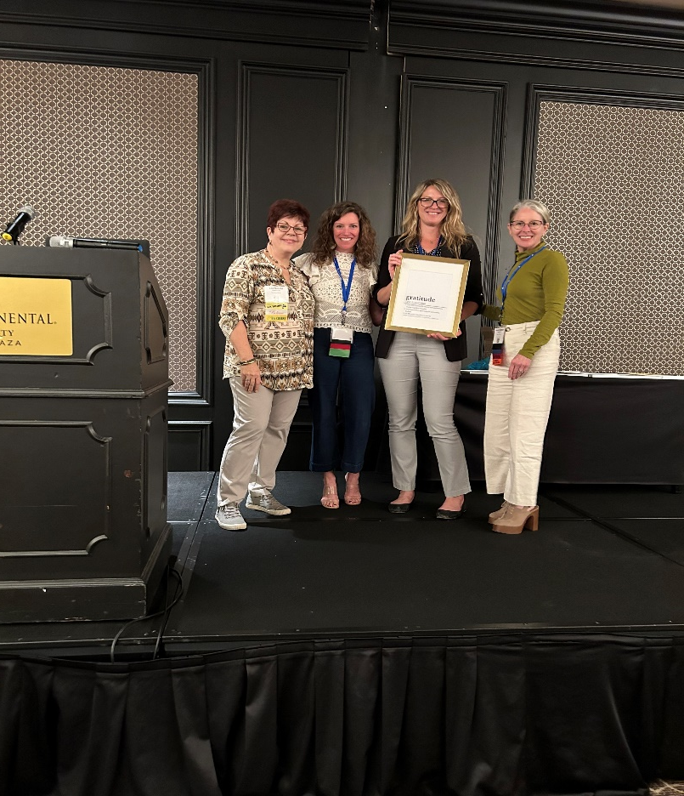
Melody Bettenhausen was awarded the 2024 VisionServe Alliance Cathy Holden Award for Managerial Excellence.
CELEBRATING 22 YEARS of SERVICE!​

Slide 25
Companion Program Thoughts...
Calling Lions throughout Colorado!!!
Companion program matching up Lions members with Ensight patients across the state.
Lions would schedule in person or phone meetings with patients.
Isolation, depression, loneliness are common amongst our patients. Ensight is looking at new ways to combat these things.
CELEBRATING 22 YEARS of SERVICE!​

